Slide 1

IT Support Ticket Performance Analysis
Data-Driven Insights & Operational Recommendations
Presented by: ABHISHEK KUMAR SINGH
Date: 29/03/2026

Slide 2
Introduction and Objectives
Context: Analysis of 97,498 IT support tickets spanning from 2016 to 2020.
Goal: Evaluate team efficiency, identify category-specific bottlenecks, and optimize resource allocation.
Objectives:
  Analyze ticket volume growth and seasonal trends.
  Measure Resolution Time (MTTR) across different categories.
  Assess Agent performance based on age demographics and satisfaction.
  Provide data-backed investment strategies for 2021.

Slide 3

Data Overview
Dataset Summary: 97,498 records with 16 key attributes including Severity, Priority, and Satisfaction.
Key Attributes:
  Ticket ID, Category (Hardware, Software, System, Login), and Issue Type.
  Agent Metrics: Agent ID, Name, Age, and Performance Ratio.
  Service Metrics: Resolution Time (Days), SLA Status (Met/Breached).
Data Cleaning:
  Handled unclassified severity levels.
  Calculated 'Performance Ratio' (Satisfaction / Resolution Time) to normalize quality vs. speed.

Slide 4
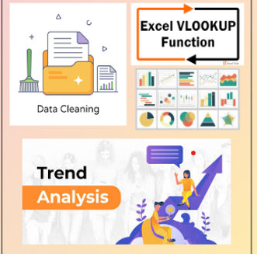
Methodology
Analytical Tools: Excel Pivot Tables, Power Query for cleaning, and Python for advanced trend modeling.
Methods Used:
Statistical Analysis: Calculating Mean Resolution Times and Satisfaction benchmarks
Trend Analysis: Mapping ticket volume growth over a 5-year horizon.
Cross-Tabulation: Correlating Agent Age with Service Quality.
Visualization: Combo charts to compare Volume vs. Satisfaction Rates.

Slide 5

Ticket Volume & Growth Trends
Growth: Total volume increased by 123% from 2016 (13k) to 2020 (29k).
Daily Demand: The team manages an average of 53.4 tickets per day.
Peak Times: October and December are consistently high-pressure months.
Stability: May through July show the most stable operational volume.
Theory: Queuing Theory suggests that without staff scaling, peak-month latency will lead to SLA breaches.

Slide 6
As seen in the line chart, we are facing a 'Scaling Challenge.' Ticket volume has more than doubled since 2016.
Theoretically, this is known as Demand Volatility. The spikes in October and December suggest that our current fixed headcount is being overwhelmed during peak seasons, leading to a backlog that carries over into the new year."

Slide 7

Category & Complexity Analysis
Volume Distribution:
System (39,002) & Login Access (29,193) drive 70% of total volume.
Resolution Time (MTTR) Gap:
Hardware: 7.63 Days (Highest complexity).
Login Access: 0.31 Days (Highly efficient administrative tasks).
Insight: Hardware issues take 25x longer than Login resets, requiring specialized resource allocation.

Slide 8
This bar chart reveals a massive 'Complexity Gap.' While Login Access tickets are resolved in less than half a day, Hardware and System issues take 6 to 7 days. This is an application of the Pareto Principle: 70% of our volume comes from System and Login issues. By automating the simple Login resets, we can redirect our expert man-hours toward the high-complexity Hardware tasks."

Slide 9

Agent Performance & Demographics
Workforce Metrics: 50 Agents with an average age of 40.6 years.
Efficiency Leaders: Agents aged 29-33 maintain the highest Satisfaction Rate (4.23).
At-Risk Group: The 34-38 age bracket shows the highest resolution time (6.91 days).
Seniority Impact: Agents 45+ show higher emotional intelligence, maintaining stable satisfaction despite high complexity tasks.
​Workforce Profile: The average IT agent is 40.6 years old, suggesting a highly experienced team.

Slide 10
Performance Tiers:
​High Velocity (Ages 29-33): Highest satisfaction (4.23). These are your "Operational Leaders.“
​At-Risk (Ages 34-38): Longest resolution times (6.9 days). This group is identified for technical upskilling.
​Soft Skills: Agents aged 45+ maintain consistent satisfaction despite handling older, complex legacy systems.

Slide 11
Sla Compliance & tools effectiveness
​Routing Accuracy: The current tool successfully prioritizes "Urgent" tickets, resolving them in ~2 days.
​The Bottleneck: "Unassigned" tickets are the primary source of delay, staying in the queue for 5+ days before an agent is assigned.
​Tooling Verdict: The existing software is a "Ranker" but not a "Router." It identifies what is important but does not efficiently assign it to available agents.

Slide 12

Strategic Recommendations
1. Resource Expansion: Hire additional staff to lower the 1,950 tickets-per-agent ratio.
2. Automation: Implement Self-Service for 'Login Access' to automate 30% of total volume.
3. Tooling Upgrade: Invest in AI-driven triaging to reduce 'Unassigned' ticket lag.
4. Training: Conduct technical workshops for mid-tier age groups to improve MTTR.
Conclusion: Transitioning from manual resets to automated workflows is critical for 2021 scalability.

Slide 13
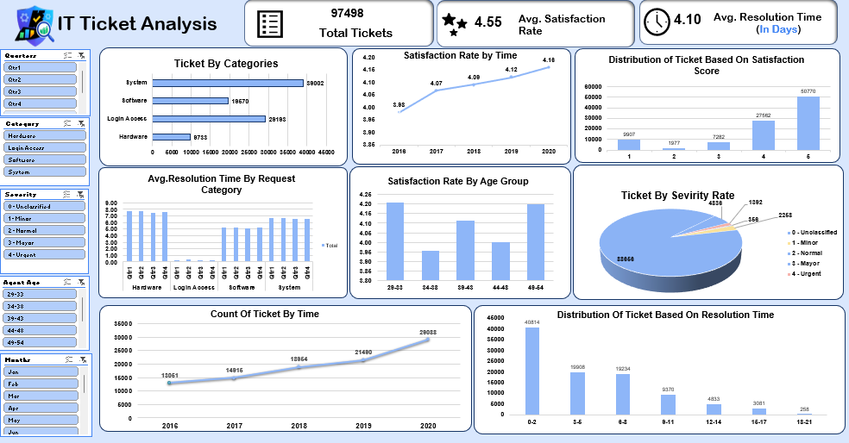
Dashboard

Slide 14

Conclusion
Current State: The IT team is high-performing but physically overwhelmed by the 123% volume growth.
Immediate ROI: Automation of low-complexity tasks provides the fastest path to MTTR (Mean Time to Resolve) reduction.
Final Vision: Transform IT from a "Support Queue" into a "Strategic Asset" by leveraging automation to allow human experts to focus on technical innovation.

